Slide 1
Gwinnett Grizzly Maps
Mike Deiters, Aston Tsou, Narith Seang

Slide 2
Project Updates
All buildings are available to view and search
You can now search for some rooms by name instead of just room number
The landing page is now the full map of campus
We have a help tab and a developer’s tab

Slide 3
Technology Stack & Data Architecture
Our app is static, but we have implemented a dynamically loading system
Pure Javascript (no jQuery, etc.)
JSON for room names
SASS and Compass with Susy
Notes:
Our dynamic loading system allows us to have one home page and load each of the maps into the app as needed
We decided early on that we did not want to use jQuery.
Why bloat the app up with a lot of extra features that we don’t need and potentially increase the load times of the app.
We created a json file to link room names to room ids
SASS and Compass is a precompiler for CSS ad allowed us to design the app quicker and easier
Susy if a framework that helps create responsive grids for our app

Slide 4
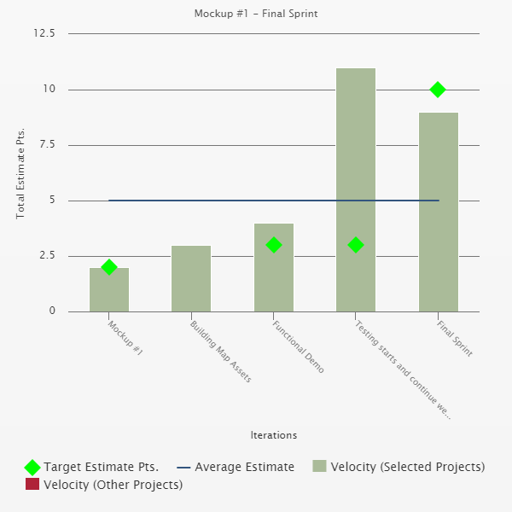
Velocity Chart

Slide 5
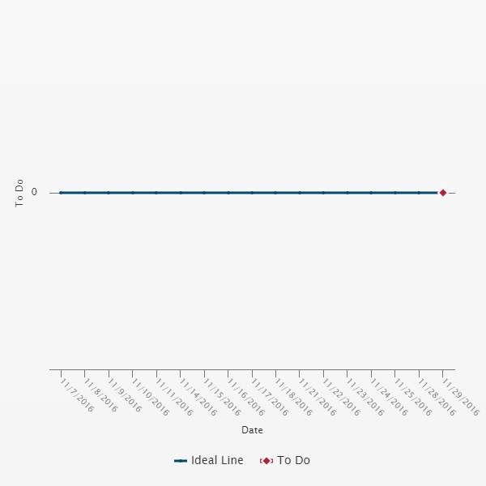
Burndown Chart

Slide 6
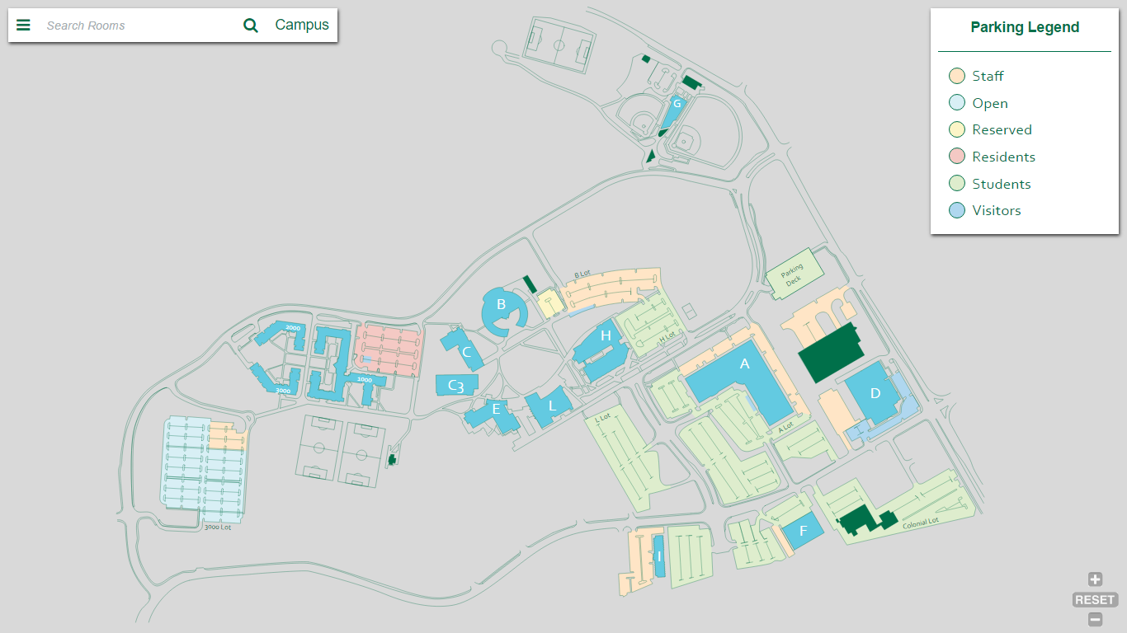
Landing Page

Slide 7
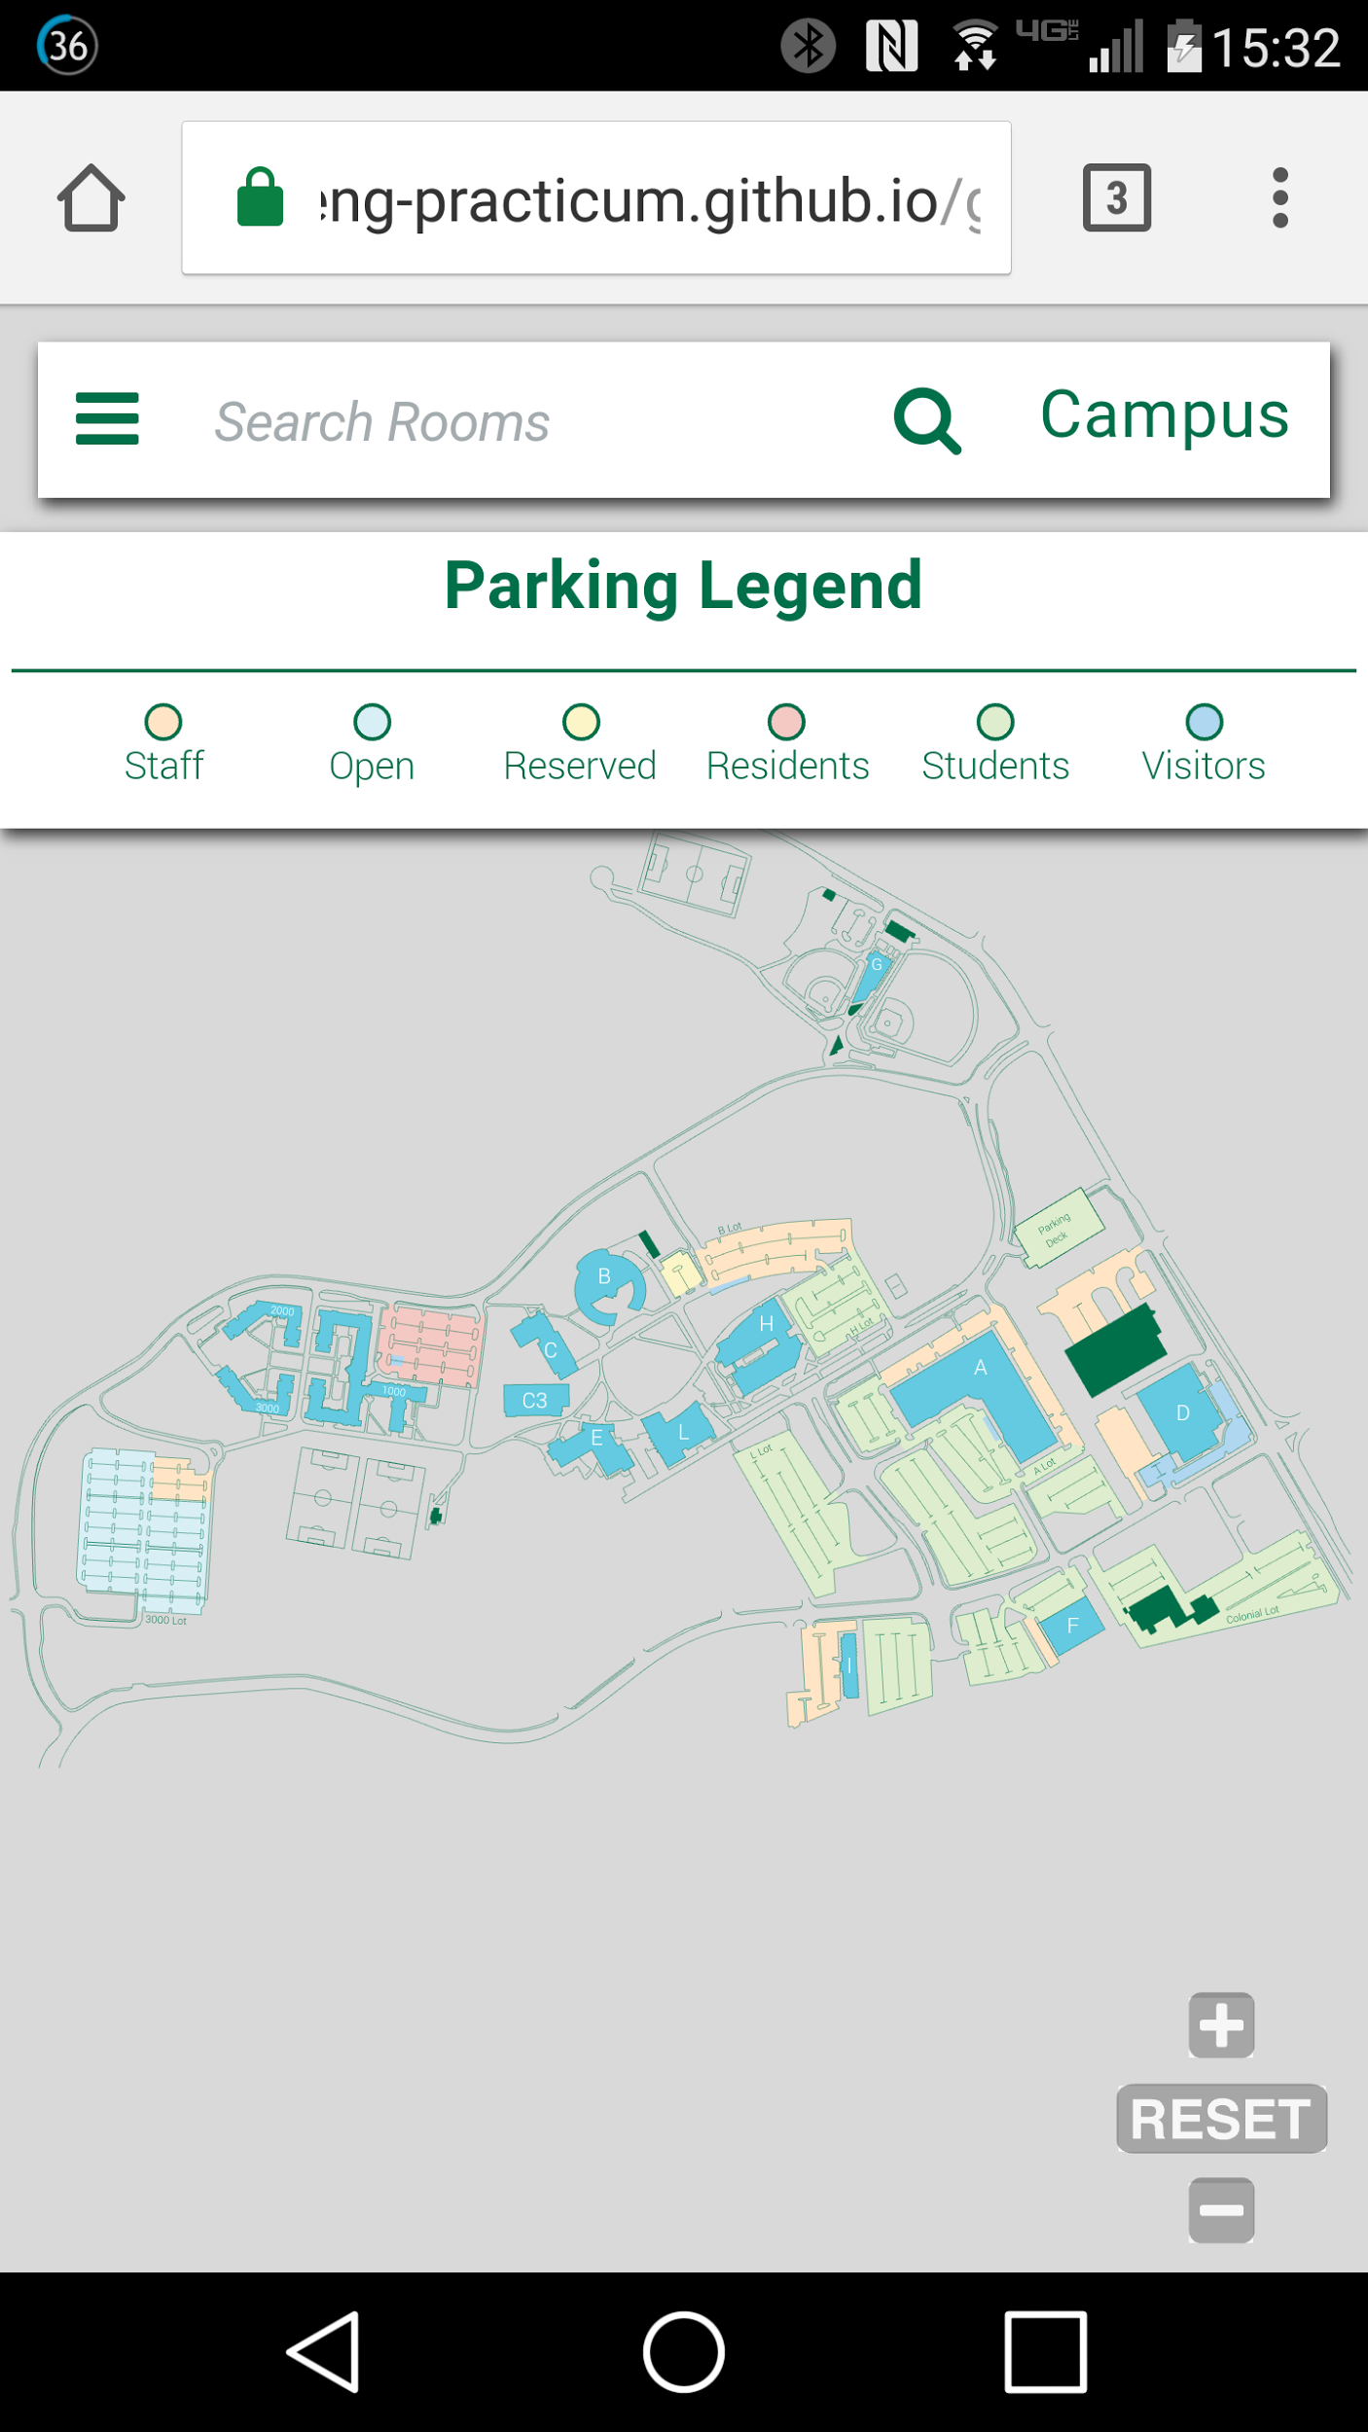
Mobile Landing

Slide 8
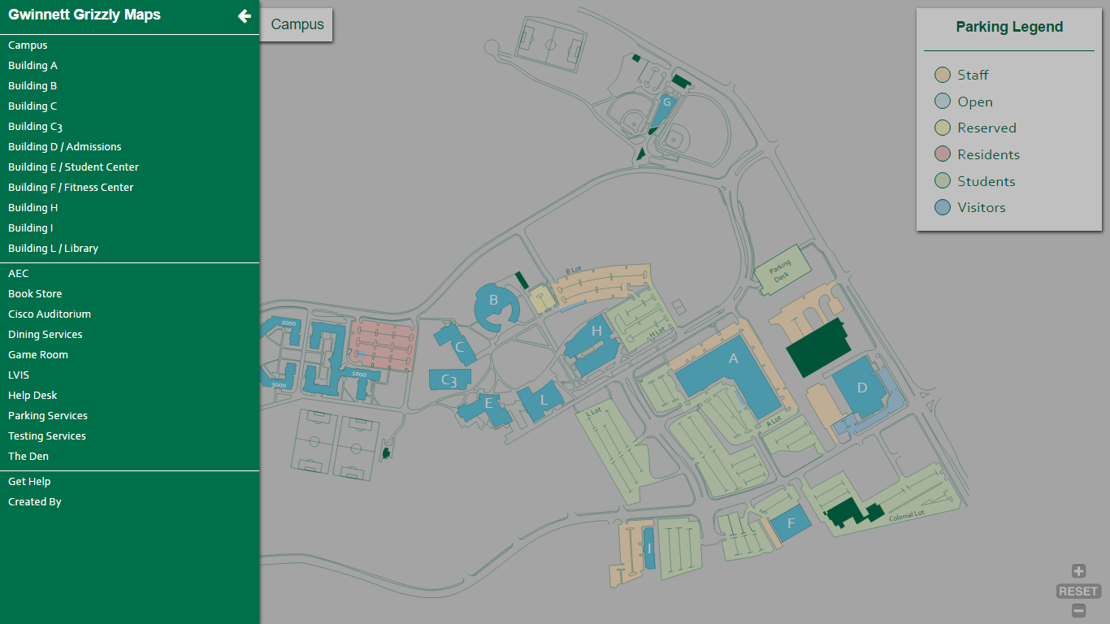
Menu Tab

Slide 9
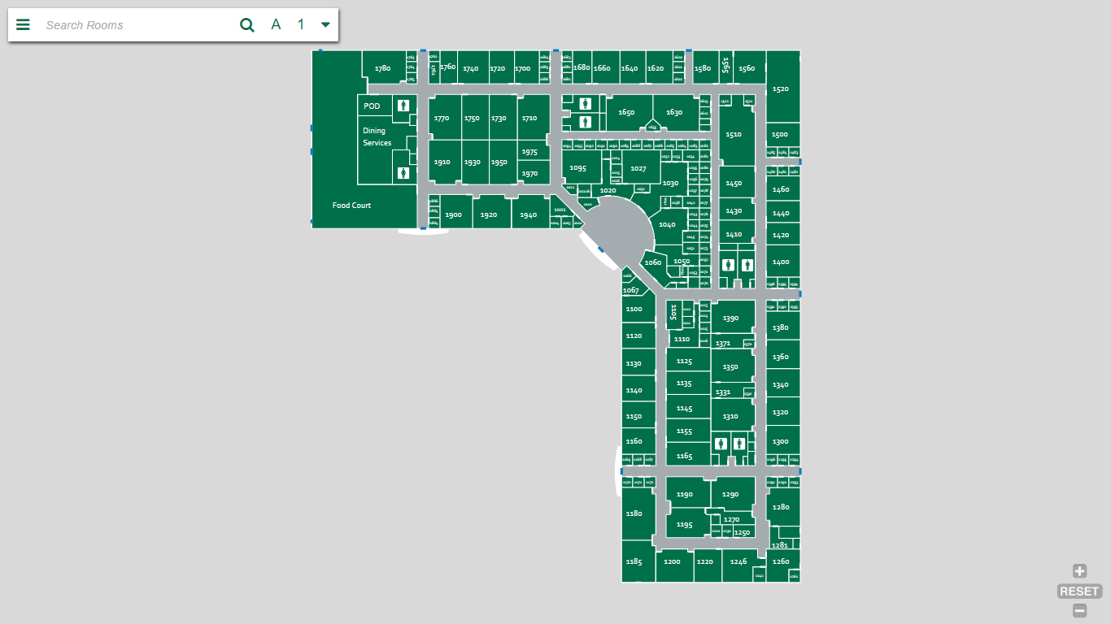
Building View

Slide 10
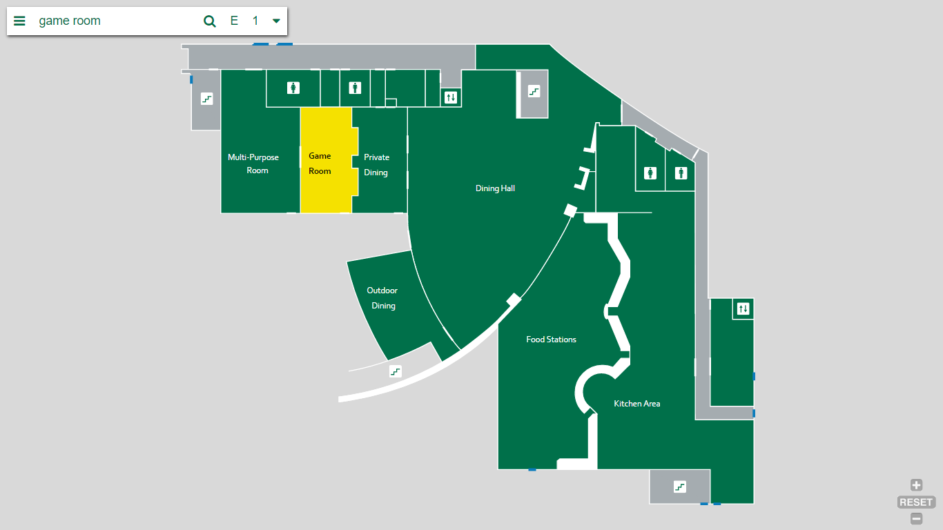
Room Search

Slide 11
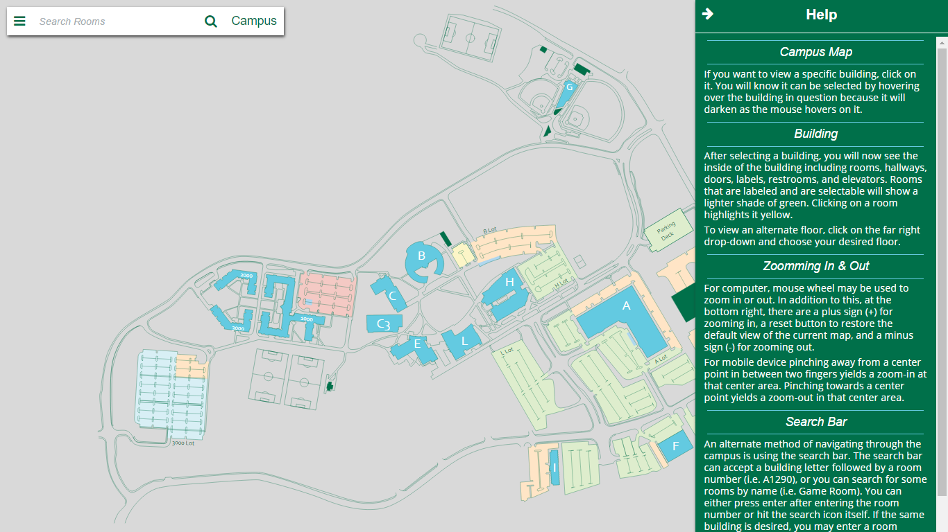
Help Tab

Slide 12
Testing
User Testing was performed as building maps were implemented
New maps were tested by new groups of people
There was a miscommunication with our client and the distribution of the app so there were many surveys that were taken that have to be thrown out.
GGM MAP: soft-eng-practicum.github.io/ggm
Survey: https://docs.google.com/forms/d/1GavR9QYzEYSZ1eLda_Us6qejIYsI_QXIYpWfGt9jTnA

Slide 13
Documentation - Github organization
App
Our running application files are in here including javascript, but not html files
Bugfix
Bug fixing folder, we started using, but ended with using GitHub issues tab
Docs
Building htmls, compiled css, minified javascript, images index.html
Maps
Original SVGs in Adobe Illustrator format
Planning
Mock-up, proposed help document, license agreement, notes, requirements in the readme
Presentations
Group Presentations

Slide 14
Documentation - Site Help
Campus Map
If you want to view a specific building, click on it. You will know it can be selected by hovering over the building in question because it will darken as the mouse hovers on it.
Building
After selecting a building, you will now see the inside of the building including rooms, hallways, doors, labels, restrooms, and elevators. Rooms that are labeled and are selectable will show a lighter shade of green. Clicking on a room highlights it yellow.
To view an alternate floor, click on the far right drop-down and choose your desired floor.

Slide 15
Documentation - Site Help
Zooming In and Out
For computer, mouse wheel may be used to zoom in or out. In addition to this, at the bottom right, there are a plus sign (+) for zooming in, a reset button to restore the default view of the current map, and a minus sign (-) for zooming out.
For mobile device pinching away from a center point in between two fingers yields a zoom-in at that center area. Pinching towards a center point yields a zoom-out in that center area.
Search Bar
An alternate method of navigating through the campus is using the search bar. The search bar can accept a building letter followed by a room number (i.e. A1290), or you can search for some rooms by name (i.e. Game Room). You can either press enter after entering the room number or hit the search icon itself. If the same building is desired, you may enter a room number without a letter, which assumes again that it is in the same building.

Slide 16
License
You are free to:
Share — copy and redistribute the material in any medium or format
Adapt — remix, transform, and build upon the material
The licensor cannot revoke these freedoms as long as you follow the license terms.
Under the following terms:
Attribution — You must give appropriate credit, provide a link to the license, and indicate if changes were made. You may do so in any reasonable manner, but not in any way that suggests the licensor endorses you or your use.
NonCommercial — You may not use the material for commercial purposes.
ShareAlike — If you remix, transform, or build upon the material, you must distribute your contributions under the same license as the original.
No additional restrictions — You may not apply legal terms or technological measures that legally restrict others from doing anything the license permits.

Slide 17
Intellectual Property
Our client did not want a stake in the application
We are splitting it evenly 32% a piece
Gunay has a 4% slice of the pie

Slide 18
Future Plans
Talk to GGC about implementing the app in place of current maps
Maybe add some features

